Slide 1
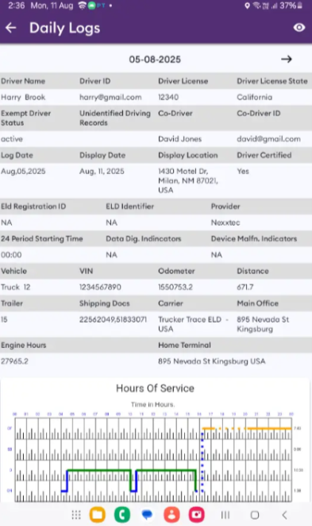
Instructions
TRUCKER TRACE ELD Inspection Mode
Tap “Dot Inspection” in the menu & press “Start Inspection”. Let an officer to view your logs directly from your mobile device. Show this instruction card if requested.
An inspector may press arrow to view previous or next day’s logs.
An inspector may view the log from, the log graph and the log events with notes
Exit the inspection mode by pressing back arrow in the left top corner of the app.
Exit the inspection mode by pressing back arrow in the left top corner of the app.
Send Logs
Trucker Trace ELD is capable of producing and transferring the ELD records via telematics transfer methods: Wireless Web services and Email. In order to send the ELD records via Web services a driver must press “DOT Inspection” menu item and then press “Send Logs” button. In order to send the ELD records via Email a driver must press “DOT Inspection” menu item, press “Email Logs”, enter an email provided by an authorized safety official and press “Send” button.
https://truckertraceeld.com
Contact the support team at support@truckertraceeld.com

Slide 2
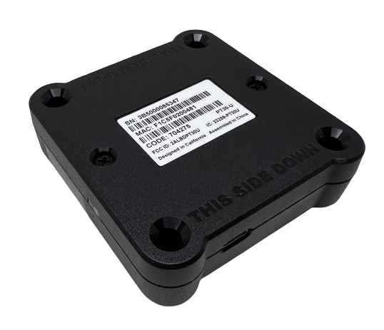
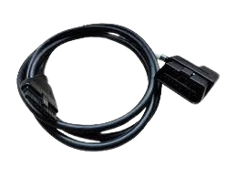
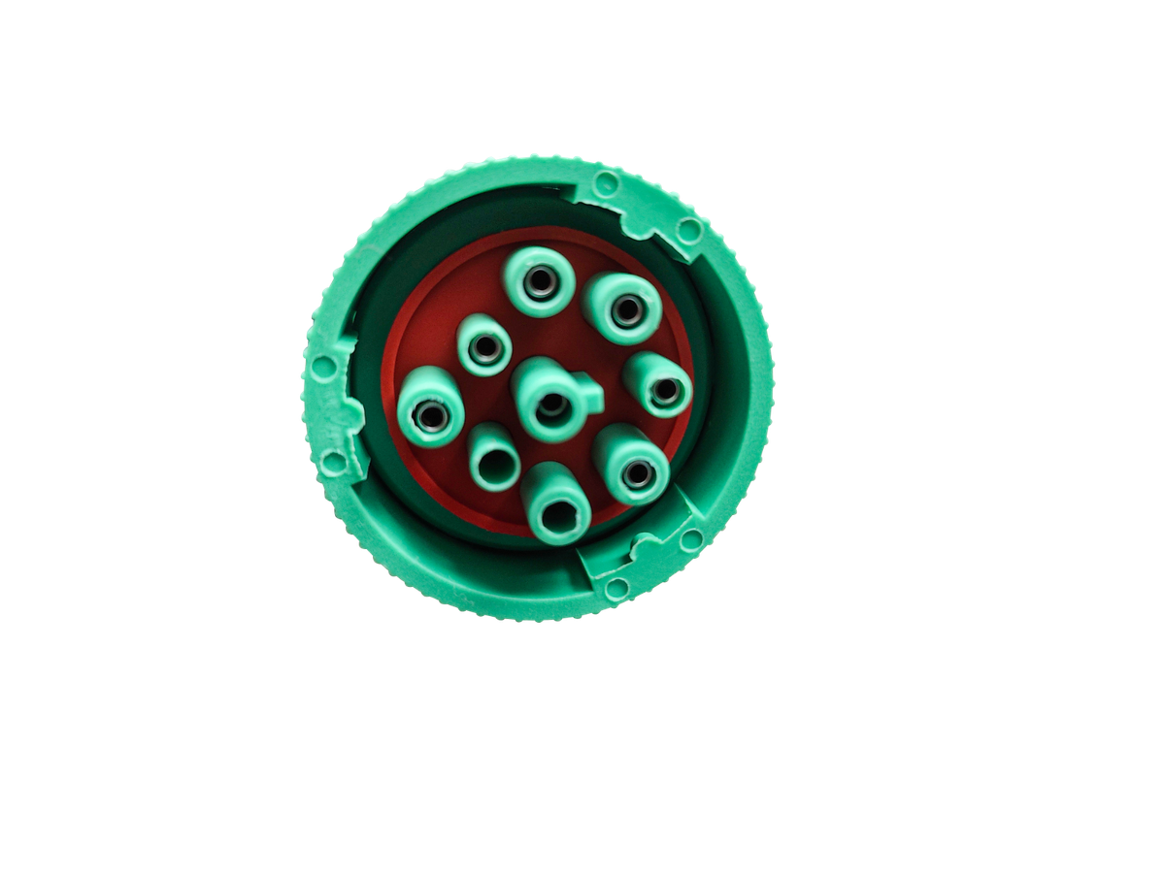
Instructions
TRUCKER TRACE ELD Malfunction Manual
EXCEL ELD Inspection Mode
In accordance with the guidelines set forth in 395.34
Tap “Dot Inspection” in the menu & press “Start Inspection”. Let an officer to view your logs directly from your mobile device. Show this instruction card if requested.
Malfunction indication
Immediately contact the support if LED light on the device is off when the device is plugged into the diagnostic port or if the malfunction reported by the app.
Note the malfunction
Note the malfunction and provide a written notice to your fleet within 24 hours.
Switch to paper logs
Keep a paper log for that day until the device is repaired or replaced. In the event of an inspection, display the previous 7 days from the app.
8 days rule
In the event of an ELD malfunction, the motor carrier must take actions to correct the malfunction within 8 days of discovery.
www.truckertraceeld.com
Contact the support team at support@truckertraceeld.com

